Slide 1
Microphase Segregation of Polyelectrolyte Brushes
Takashi Yokokura
Advisor: Prof. Rui Wang
UC Berkeley, Chemical and Biomolecular Engineering
Charged and Ion-Containing Polymers I
3/6/2023, 8:00 am - 11:00 am

Slide 2


Introduction
Polyelectrolyte brushes (PEBs) are particularly promising for interfacial modification, “smart” materials, and as model systems in biology
A comprehensive understanding of the underlying physics is necessary for
Discovery of new conformational targets and transition mechanisms
Polymer design strategies for desired phenomena
Biofouling
Aggregation mechanisms
pH-sensitive flow valves
Protein distribution
Lubrication
Mutation effects
(Chen, et al., Macromolecules, 2017 )
(Yuan, et. al., J. Cell Sci., 2012)

Slide 3
Motivation
Theory allows for the study of mechanisms and structures throughout the entire parameter space (chain length, charge fraction, solubility, etc.)
There has not been a systematic study of the coupling between polymer conformation and the interactions with its surroundings in PEBs
Standard buildup from statistical mechanics allows for straightforward implementation of additional interactions, such as
Ion fluctuations (multivalent ions / charge inversion)
Excluded volume effects
Multi-chain interactions

Slide 4





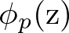
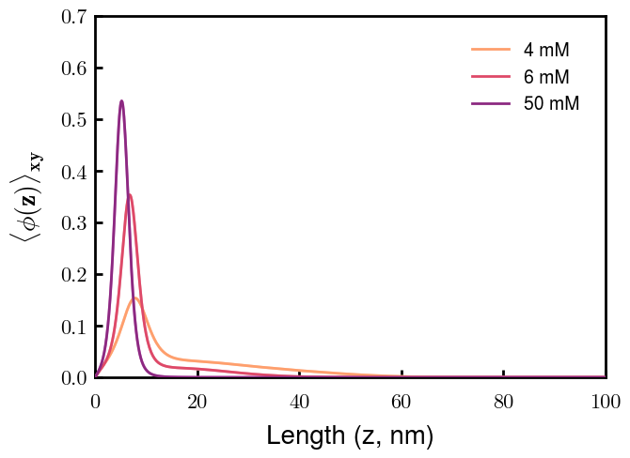
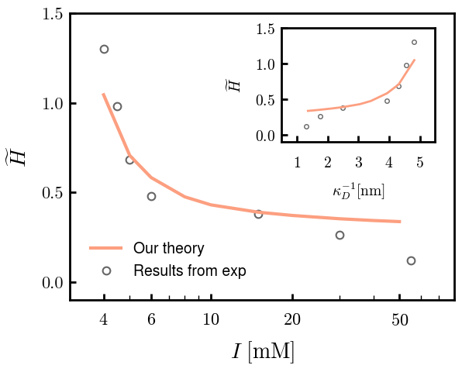
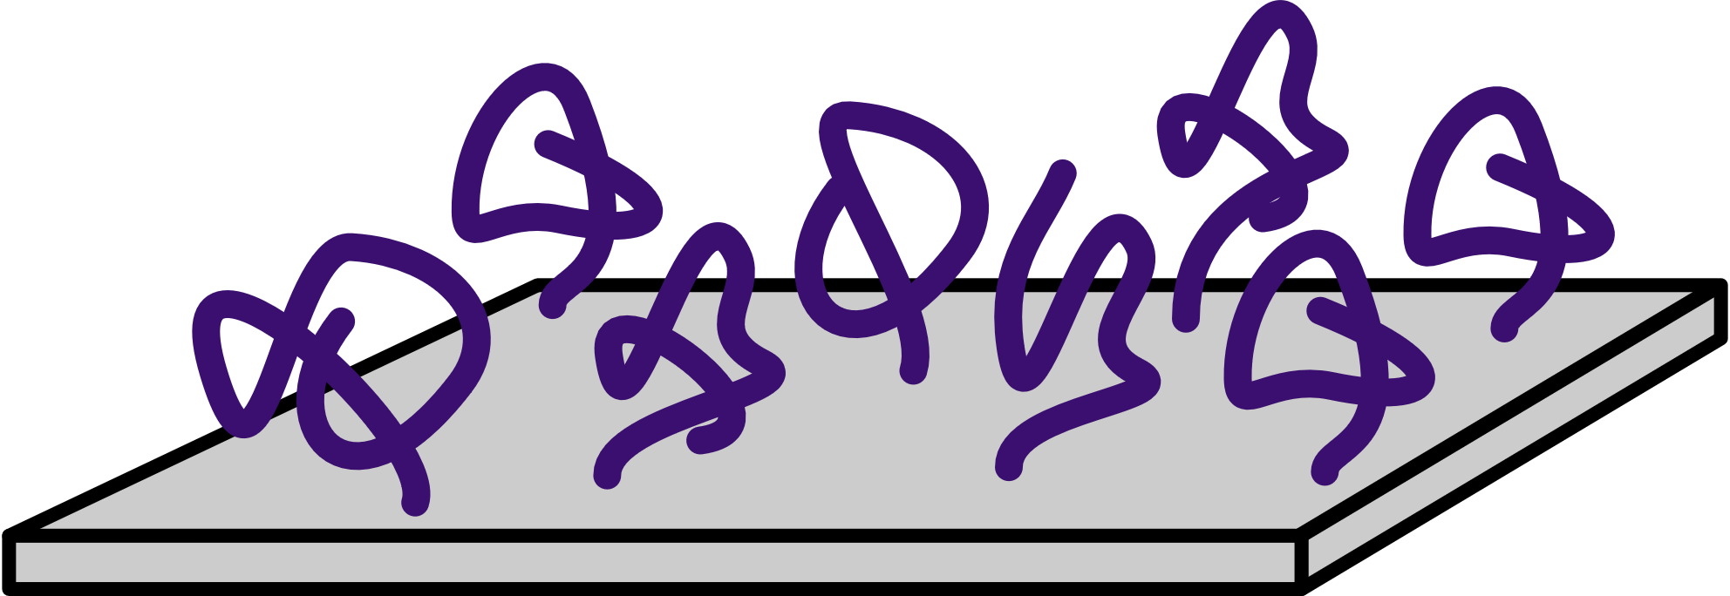
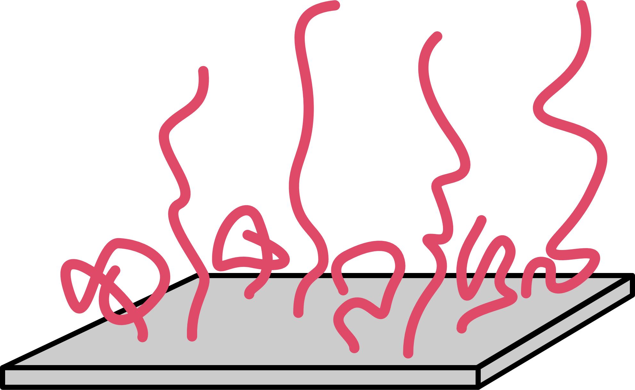
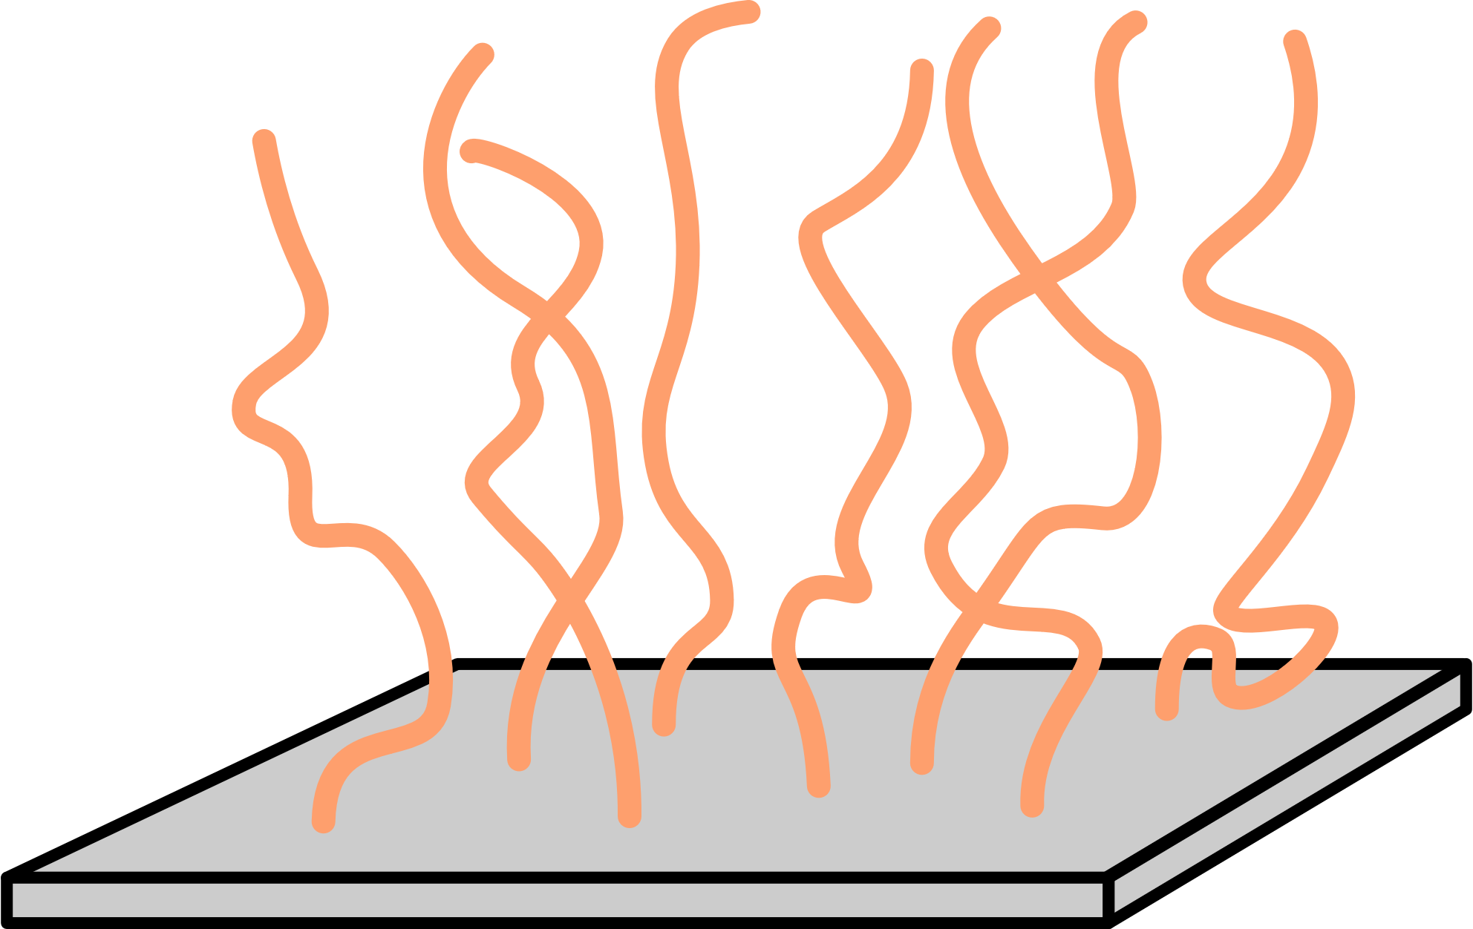
Presentation Overview
Theory
Systematic Study
Repulsive
Attractive
Application to Experiments

Slide 5






Partition Function Formulation
+
s
s
-
Elastic entropy following Gaussian statistics
+
-
+
s
s
Flory-Huggins short-range interactions
s
-
+
+
+
+
+
+
+
+
+
s
-
s
+
Electrostatic correlations
-
+
s
s
-
Local incompressibility
s
+
+
s

Slide 6














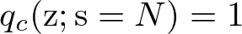
Free Energy and SCF Equations
Free Energy (ensemble average across surface)
Functional Minimization
Polymer Density:
Polymer-controlling Field:
Solvent Density:
Solvent-controlling Field:
Incompressibility:
Monomer Probability:
Electrostatic Potential:

Slide 7
Presentation Overview
Theory
Systematic Study
Repulsive
Attractive
Application to Experiments

Slide 8
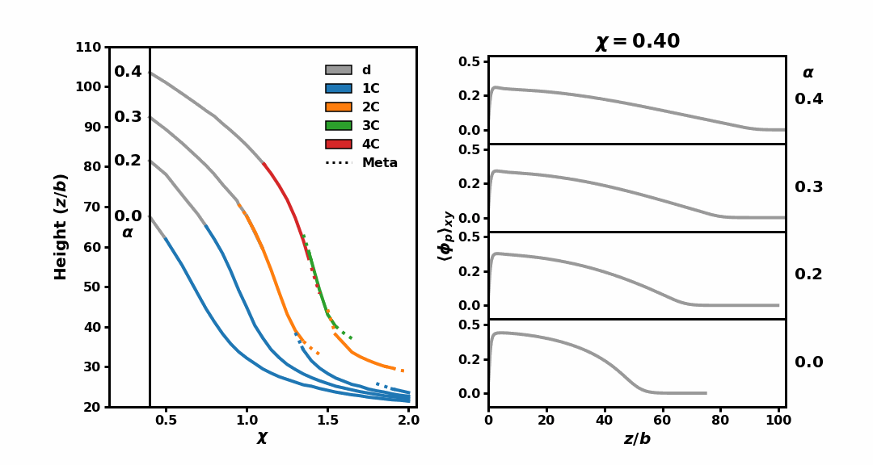


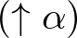


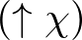


Number of layers tunable with polymer charge fraction
For $α=0.40$ (const. repulsive)
s
s
s
+
s
+
s
+
+
+
+
+
s
s
+
+
s
s
s
+
s
s
Attractive
Repulsive
Vol. fraction
Smeared charge
Flory-Huggins
Key observations:
High repulsion enriches conformational space
At intermediate repulsion, multiple condensed layers coexist with a dilute layer
High relative attraction eventually causes loss of sensitivity to repulsion

Slide 9



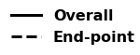

Chain organization within brush is deducible by SCFT
Two candidates with identical averaged density profiles
2 condensed
“Locked-in-layer” minimizes elastic penalty with mushroom conformations
Energetic cost of segregation scales with the “stem” traversing layers
4 condensed + 1 dilute
“Locked-in-layer”
“Pearl-necklace-like”
(Endpoint densities x 30)

Slide 10
Presentation Overview
Theory
Systematic Study
Repulsive
Attractive
Application to Experiments

Slide 11
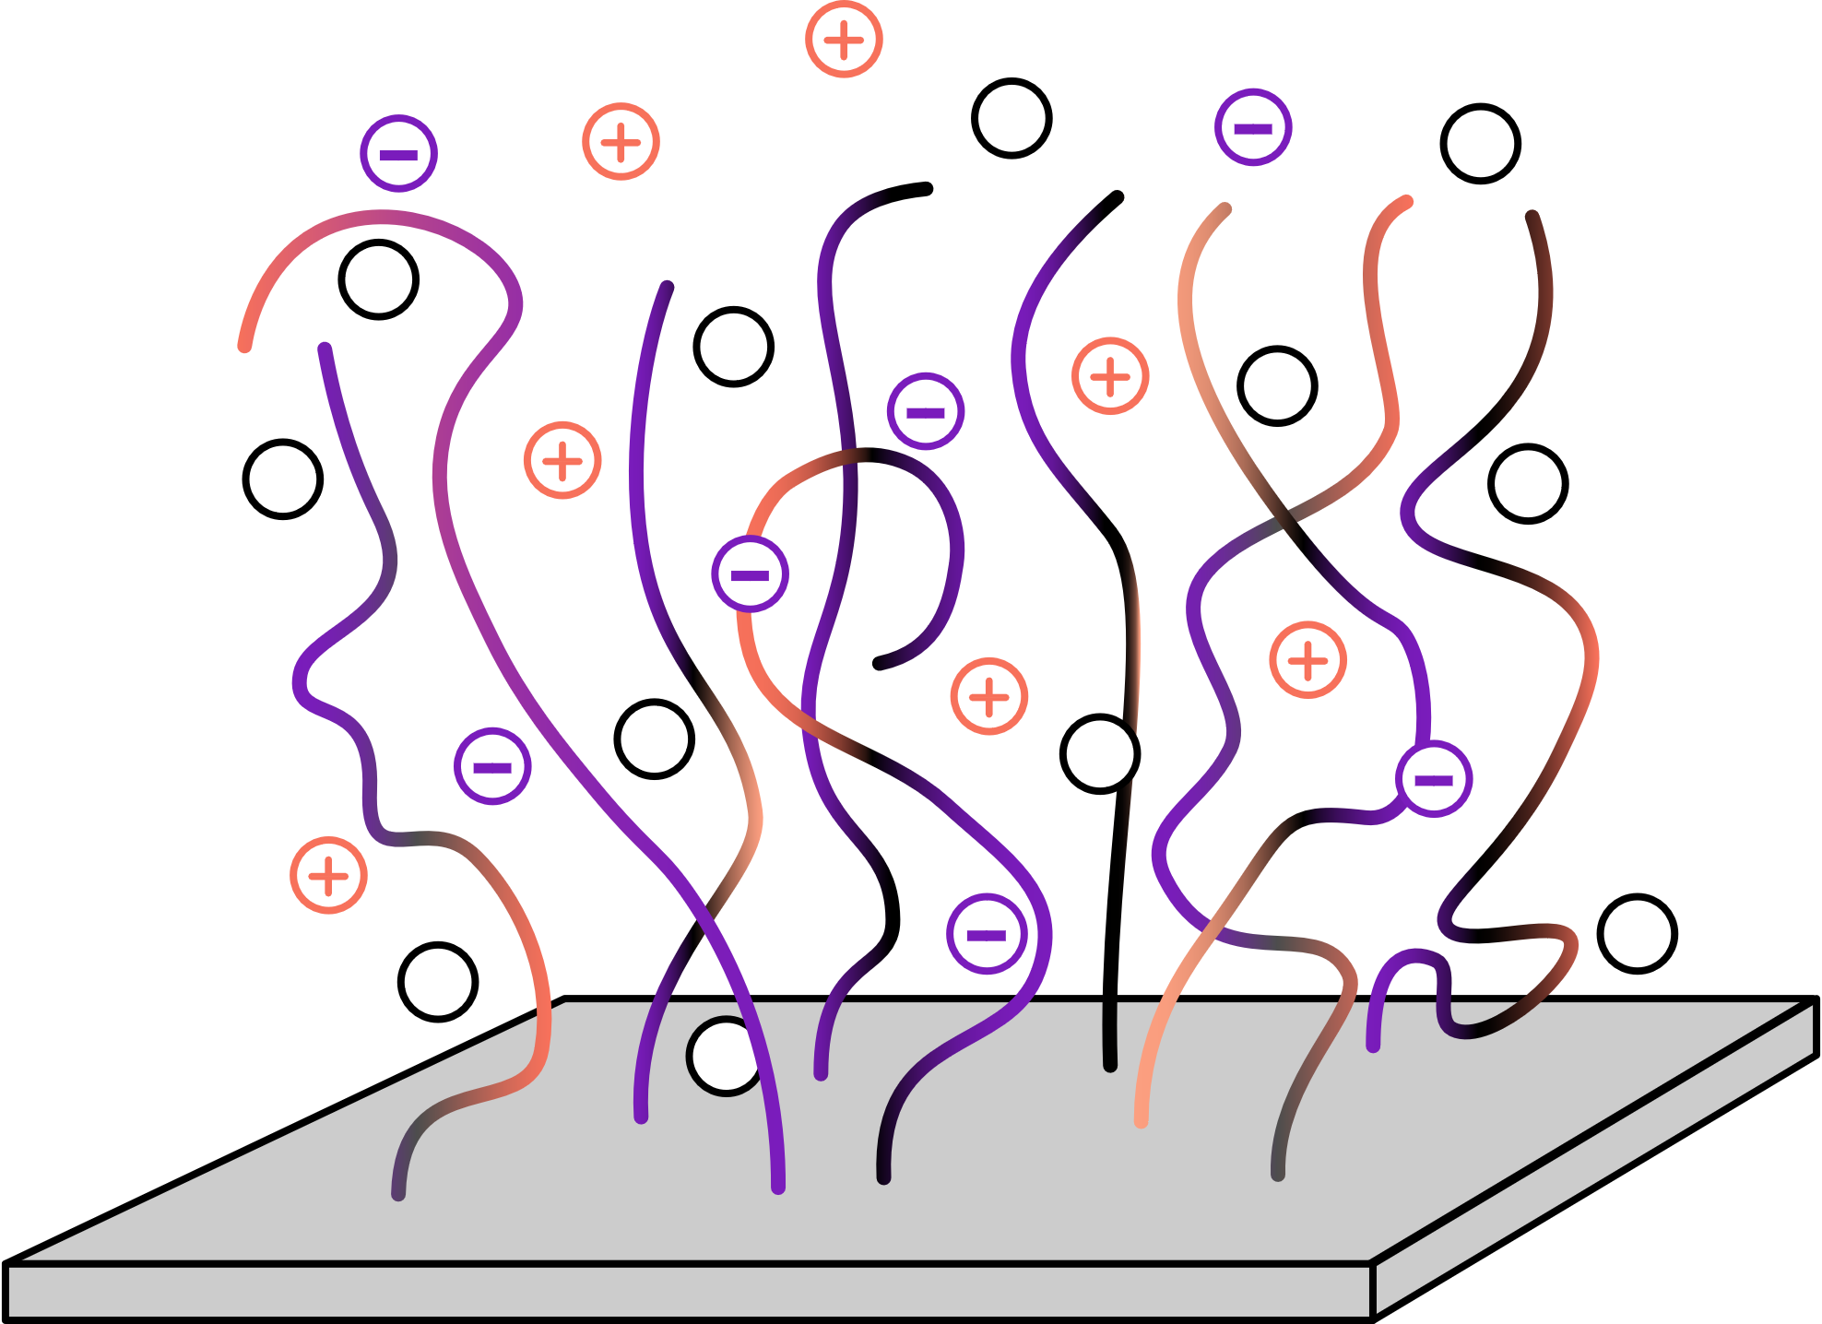
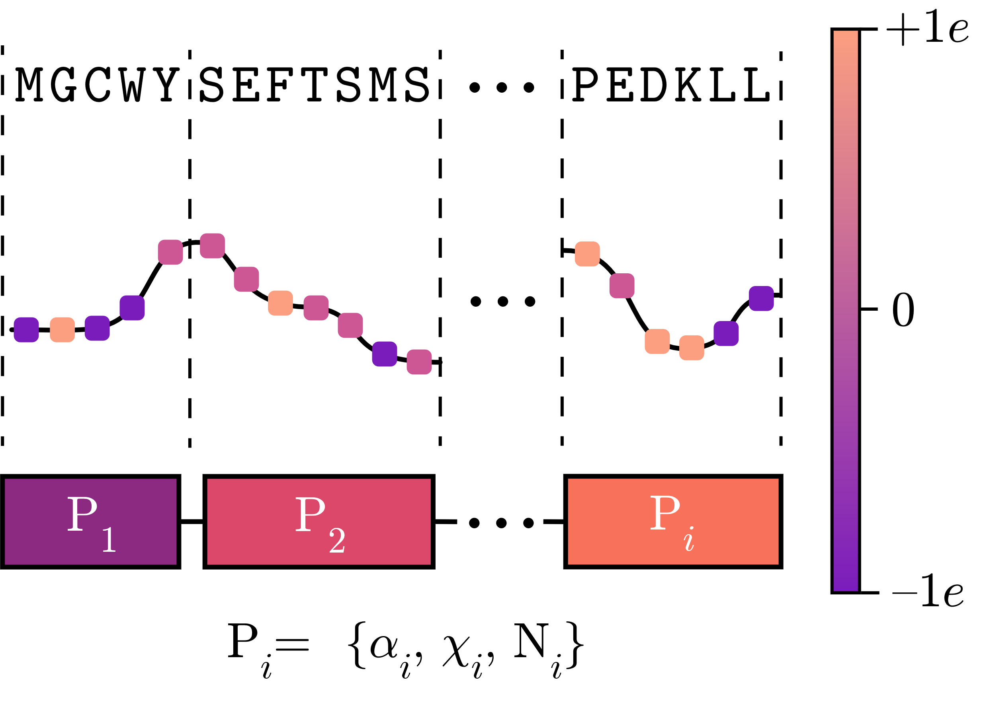
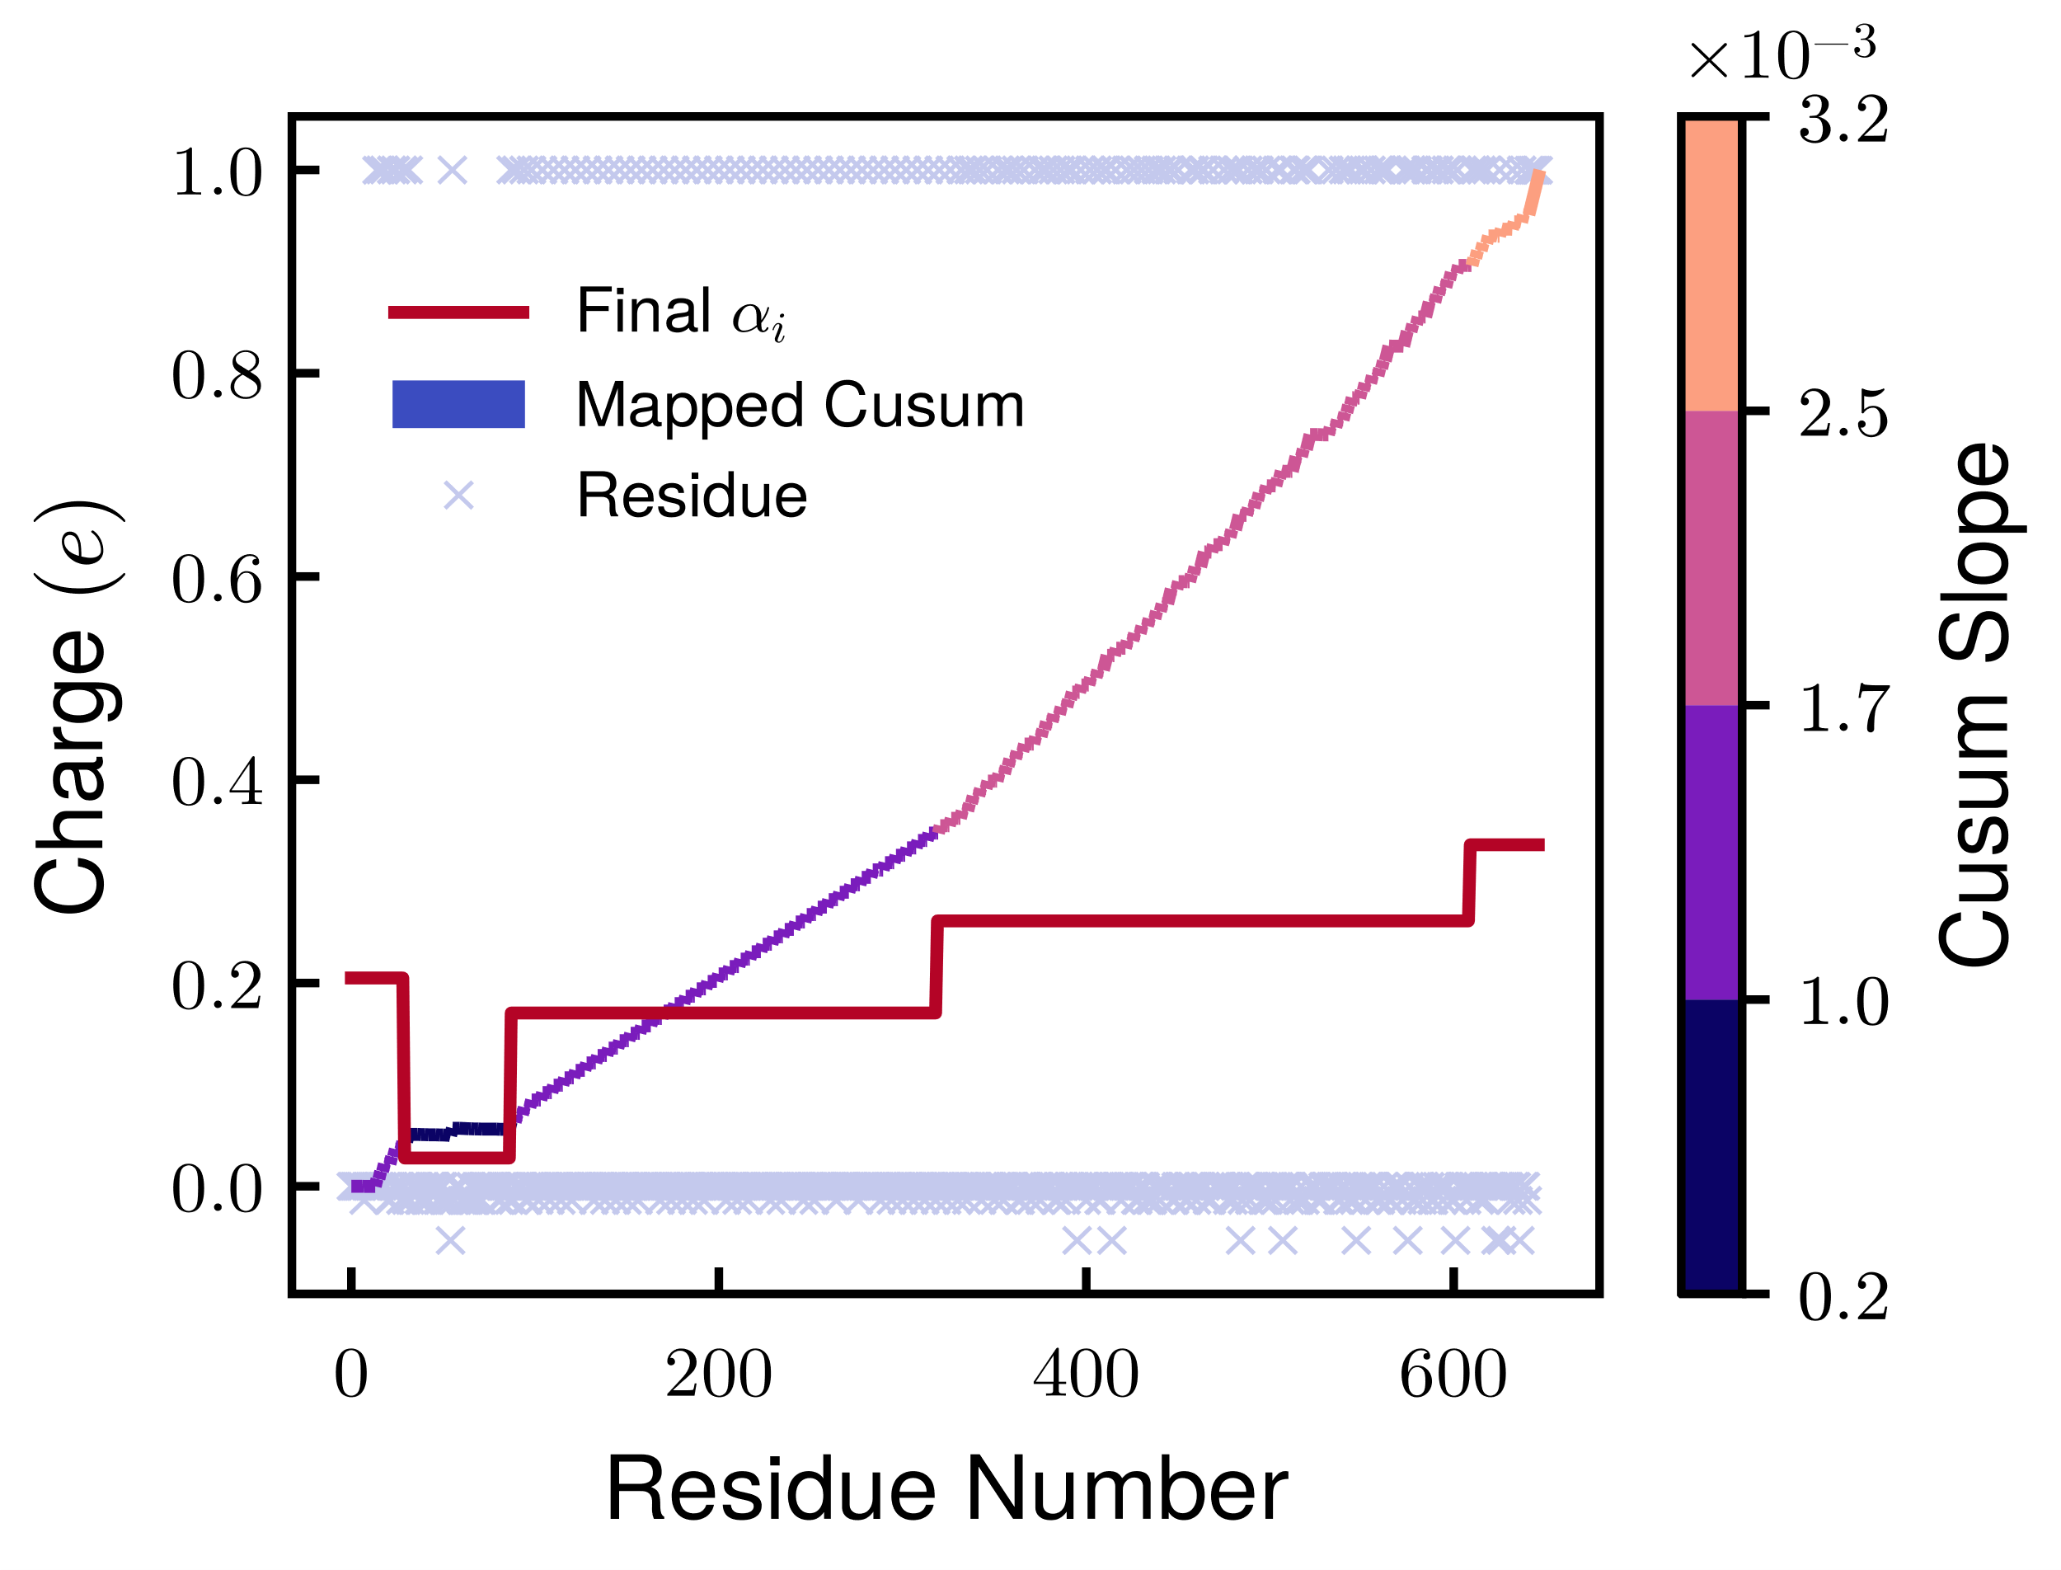
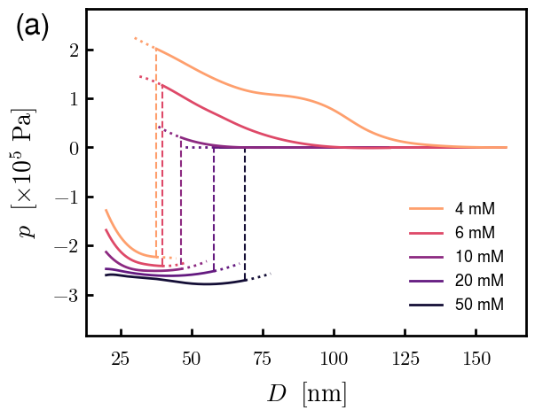
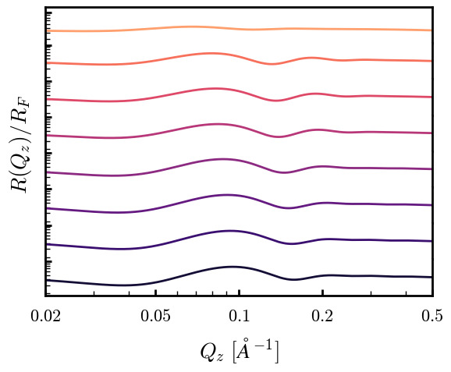
Framework provides structural and mechanistic information for an IDP-derived brush
Neurofilament Heavy (NFH)
Coarse-graining
Experimental Comparison
Beyond Experiments
I
I

Slide 12
Conclusions
SCFT accurately describes the coupled interactions within PEBs and provides experimentally inaccessible information
High charge fraction facilitates microphase segregation in PEBs
Each layer as subsequent mushroom conformations (“locked-in-layer” model)
IDP brush derived from NFH is well-described by our model
Polymer density profiles
Predicted characterization spectra
Reflectivity and brush-brush force

Slide 13




Acknowledgements
Wang Group
Prof. Rui Wang
Dr. Chao Duan
Nikhil Agrawal
Luofu Liu
Dr. Chao Fang
Ian Woolsey
This material is based upon work supported by the National Science Foundation Graduate Research Fellowship under Grant No. DGE 2146752

Slide 14
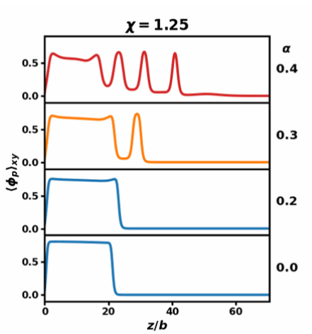
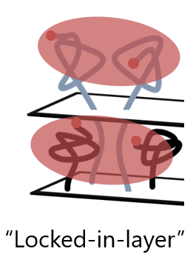

Thank you!
Systematic Study
Application to IDP

Slide 15
Supplemental Slides
Full partition function
NFH pressure dilute-coex transition mechanism
NFH coarse-graining parameters (and H formula)
Henderson-Hasselbalch
SCFT Flowchart
Reflectivity master equation
Block-polymer SCFT equations

Slide 16
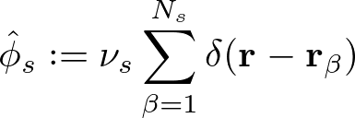



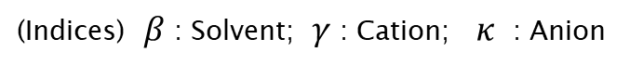
Full Partition Function
(Subscripts) $s$ : Solvent; $p$ : Polymer; $e$ : Charged
(Indices) $β$ : Solvent; $γ$ : Cation; $κ$ : Anion
Elastic entropy following Gaussian statistics
Particle Operators
Flory-Huggins short-range interactions
Electrostatic correlations
Local incompressibility
Coulomb Operator
Semicanonical Ensemble

Slide 17
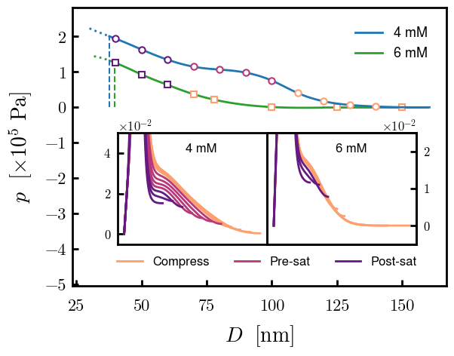
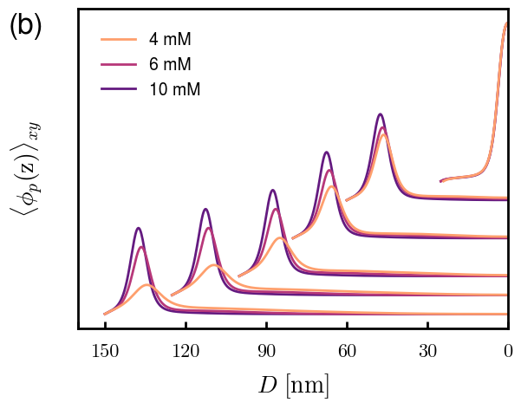
NFH pressure dilute-coex transition
4 mM vs. 6 mM mechanisms

Slide 18
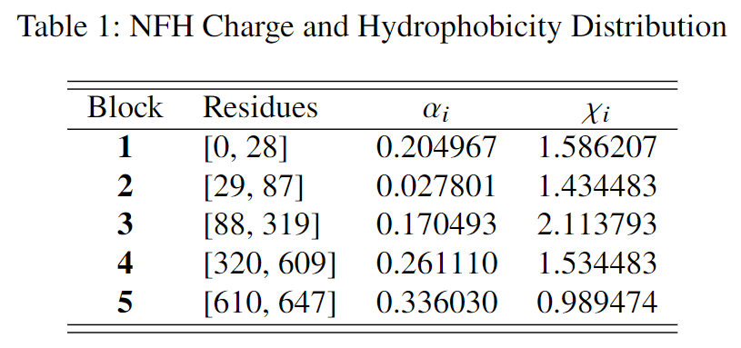
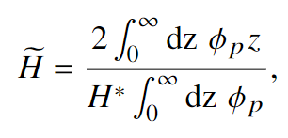
NFH Coarse-graining parameters
Vol. frac to height
Kuhn’s length and monomer volume:
b = 3.00 nm
v = 1.30 nm³

Slide 19
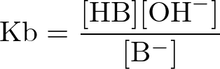
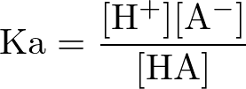
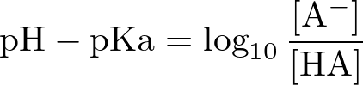
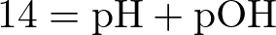
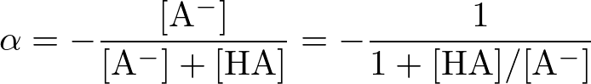
Henderson-Hasselbalch
AA | pKa | pKb
D (Aspartic Acid) | 3.65
E (Glutamic Acid) | 4.25
K (Lysine) |  | 10.53
R (Arginine) |  | 12.48
H (Histidine) |  | 6.00

Slide 20





SCFT Build-up — Flowchart
PDE Solve (for iteration k)
Propagate (using PDE solutions)
Check (for self-consistency)
Update (if not satisfied)
Anderson Mixing
Simple Mixing
Notation slightly incorrect but changed for clarity. w^{k} = f(w^{k+1/2}, w^{k-1}), where w^{k+1/2} is from SCFT calculations (\phi remains ^{k})

Slide 21
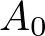
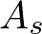
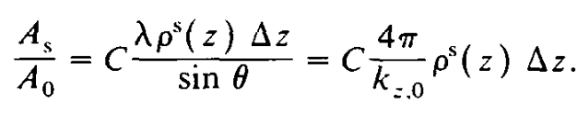
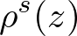
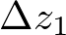
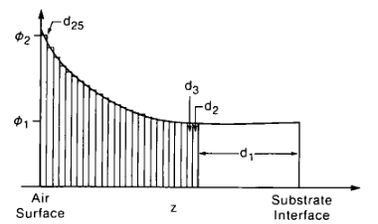
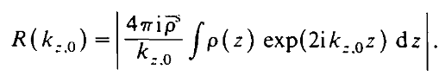
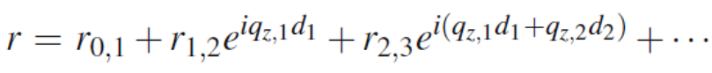
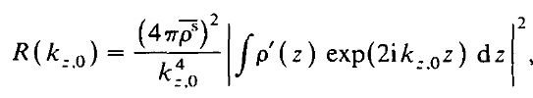
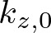

Reflectivity Master Equation Derivation
“missing” length dimension
C =i ; from integration over all area elements at z
Continuous density profile (Reimann sum analogue)
2
Phase factor for interference:
Scattered amplitude
Integration by parts
Incident amplitude
Wavelength
Scattering density proflile
Qz notation, non-normalized density, Fresnel reflectivity
Incident angle
Scattering vector
Russel, T.P., Materials Science Reports, 1990

Slide 22


Block copolymer PDEs
Mean-field Poisson-Boltzmann Equation
Modified Diffusion Equation
Block K
$$\{χ_{K},N_{K}, α_{K}\}$$
Block 2
Block 1

